Slide 1

Project Speed Cycles Sri Lanka
Hero Experience Agency

Slide 2





Our Team

Slide 3
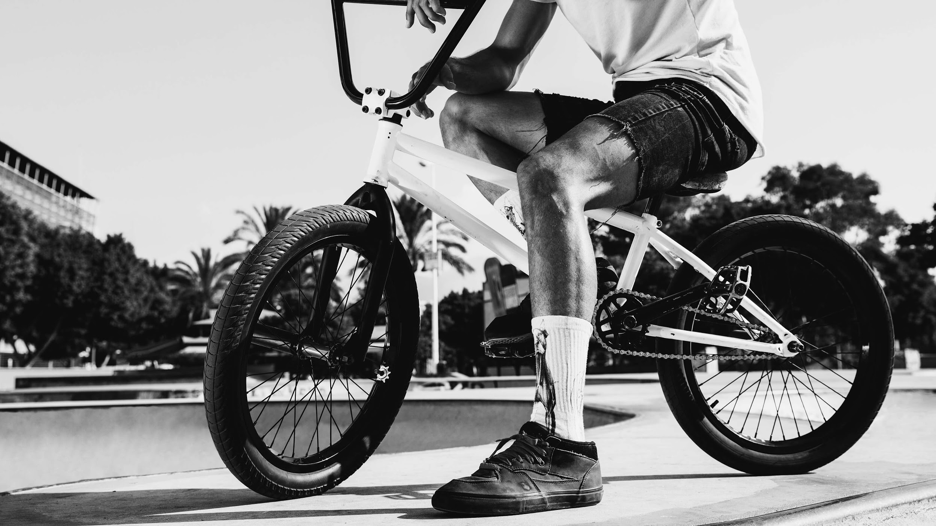
Purpose - to find out issues with the current website and - to provide recommendations in order to rebuild the website to increase sales through the website

Slide 4

There is cats

